Slide 1
Decoding the 2026 Tamil Nadu Assembly Election A DATA-ONLY SHOW
A presentation for AtliQ Media
Codebasics Resume Project Challenge
Aditya Dixit
20-05-2026

Slide 2
BREAKING DOWN A NEW PARTY’S PERFORMANCE IN TAMIL NADU 2026 STATE ELECTIONS
WHAT? – A two year old party gained the highest vote share and got the first place in most of the 234 total seats
WHY? – For the Nation’s democratic health, it is important to analyse the performance of a new party against the legacies
HOW? – We will dissect the results and associated data that was all declared by the Election Commission of India using the questions suggested by Codebasics dossier

Slide 3
EXPECTATIONS
Breakdown of 3 Questions from Codebasics dossier
A top-down approach of scale to dissect the numbers in each Question
A game with numbers – no speculation, no reasons for the data itself and no predictions for the next election cycle.
The base data will be sourced from the Codebasics provided data set and Election Commission of India.

Slide 4
THREE QUESTIONS ONE STORY
The vote share story – As compared to the 2021, how the 2026 vote share in the state changed? Who gained the most votes? Who lost them? Which Constituency
The flip game – Which constituency chose a different party in 2026 vs. 2021? Which constituency retained the party? What do the numbers say? How does it look when plotted on a Sankey Chart?
The margin of victory story – How does the average margin of victory changed from 2021 to 2026? How many victories in 2026 election were a close calls, a strong one or a dominant one?

Slide 5
SOME BASE NUMBERS
2021
2026
234 Constituencies
3859 Candidates
109 Parties
Registered Voters +62M
Voter turnout 72.73%
Votes Casted +46M
234 Constituencies
3992 Candidates
105 Parties
Registered Voters +57M
Voter turnout 85.14%
Votes Casted +49M

Slide 6
THE VOTE SHARE STORY
2021
2026
Top 10 Parties captured +94% votes on State level
Top 10 Parties captured +96% votes on State level

Slide 7
THE VOTE SHARE STORY
2021
2026

Slide 8
THE VOTE SHARE STORY

Slide 9
THE FLIP GAME

Slide 10
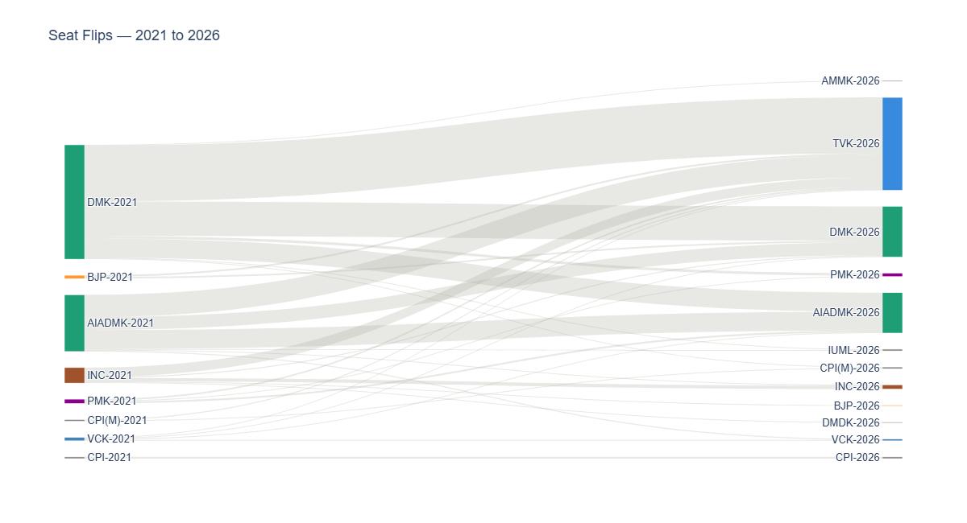
THE FLIP GAME
Sankey Chart visualizing the Seat Flip from 2021 to 2026

Slide 11
THE MARGIN OF VICTORY STORY
Margin of Victory % =
100 × (Winner votes − Runner-up votes)
(Total valid votes)
2026 Worked example
Gummidipoondi constituency no. 1:
15 Candidates + NOTA
Total valid votes — 232,522
First — TVK — 94,320 votes
Runner up — AIADMK — 66,375 votes
Margin of Victory % =
100 × (94,320 − 66,375) = 12.02%
232,522 100

Slide 12
THE MARGIN OF VICTORY STORY
Metric | 2021 | 2026 | Change
Average MOV across all 234 constituencies | 11.70% | 7.67% | −4.03 points
Notable facts – In 2021, two constituencies (19 & 129) returned margins above 50%. In 2026, none did.
- Constituency No. 86 had a strong AIADMK margin in both 2021 (37.93%) and 2026 (37.99%). The only consistent stronghold across both elections in this metric.

Slide 13
THE MARGIN OF VICTORY STORY
What was TVK’s performance with respect to the Margin of Victory Story?

Slide 14
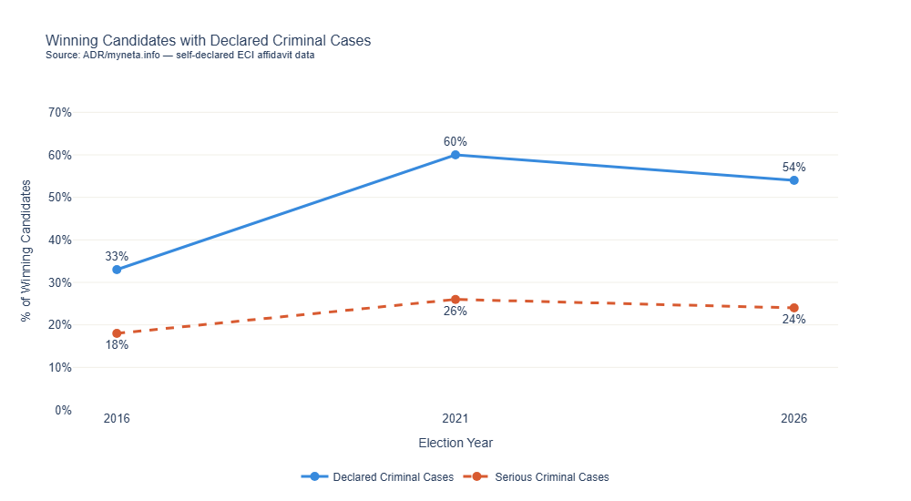
BONUS – THE CRIMINAL STORY

Slide 15
LIMITATIONS
Section | Keep
Analytical | Causality cannot be established from results data alone – Why the votes shifted? Which political or social topics were the driving force for the result?
Analytical | Turnout increase from 2021 to 2026 means some 2026 votes came from new voters — exact party split unknown
Analytical | Candidate party switching not detectable from ECI results data – Party switching is not considered for the analysis, so if the winning candidates in 2021 changed their parties in 2026 and still won, that cannot be determined
Analytical | Regional groupings are editorial convention, not official ECI classification
Analytical | MOV trend uses two years only — not sufficient to establish long term pattern 2021 & 2026 – only set a comparison for election cycles
Scope | Three questions only — Q3, Q2, Q6 – from the Codebasics dossier
Scope | No demographic breakdown possible from ECI data – which was prohibited in the rules
Scope | No exit polls, news articles, or opinion data used – prohibited by the rules

Slide 16
DATA SOURCES
Codebasics RPC Starter Dataset tn_2021_results.csv · tn_2026_results.csv · constituency_master.csv Cleaned from ECI and Trivedi Centre for Political Data, Ashoka University
Candidate Affidavit Data myneta.info — Association for Democratic Reforms Original source: ECI affidavit archive — https://affidavit.eci.gov.in/

Slide 17
DECLARATION
To the best of my knowledge and intent, this analysis is non-partisan. I have not taken any position in favour of or against any party, leader, alliance, community, or electoral outcome. Every observation in this presentation describes data only. All sources are publicly available and ECI-verified. No exit polls, news articles, opinion polls, or social media data were used at any stage of this analysis.

